Slide 1
Sencha extjs
Nam Le

Slide 2
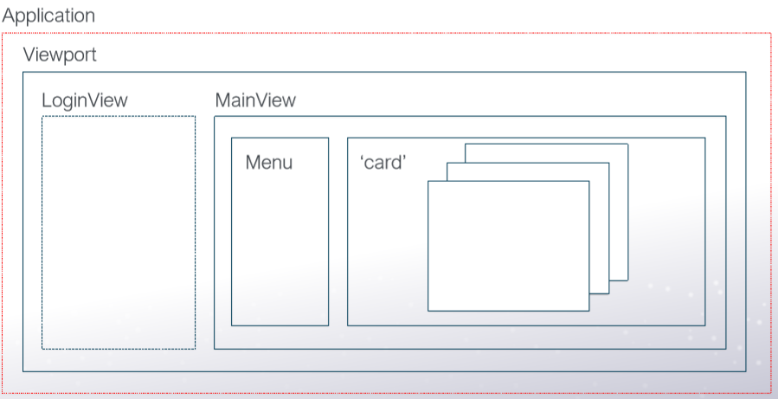
Application Architect

Slide 3
Work flow
ViewportController
Launch() profile
Launch() Application.js
onLaunch()
restoreSession()
T
F
services
Ext Ajax
mainController
showMainView()
terminateSession
Login Service
loginContl
Restful API
menuController
mainController
login()
- Even listenner
fireEvent
OtherControllers
Model
Proxy
…
- childtap listenner
- Routers: handleNavigationRoute
Proxy
Ext Store
handleDataRoute
handleLoginRoute
- setActiveItem

Slide 4
Generate Workspace and App
\> sencha -sdk “path-to-ext-6.7.0.161" generate workspace nrdtraine
\> sencha generate app modern --ext nrdEmp app

Slide 5
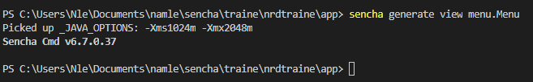
Generate view

Slide 6
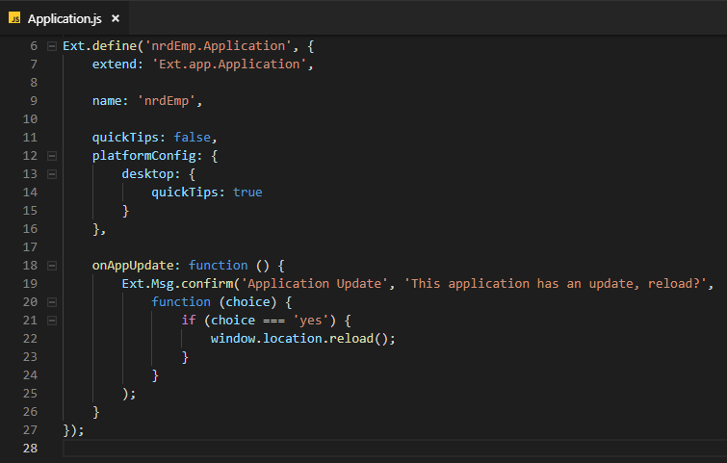
Application.js default

Slide 7
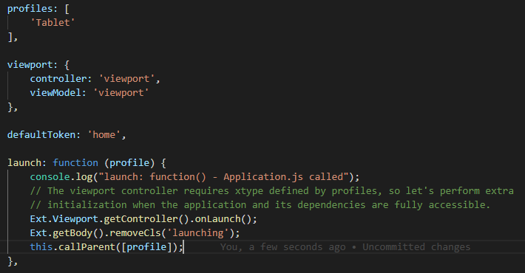
Application.js

Slide 8
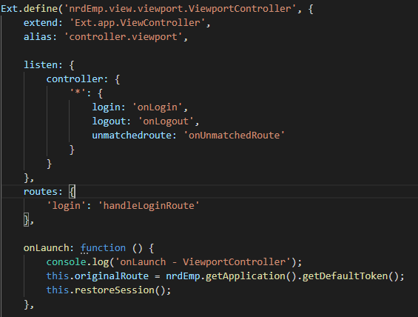
ViewPort Controller

Slide 9
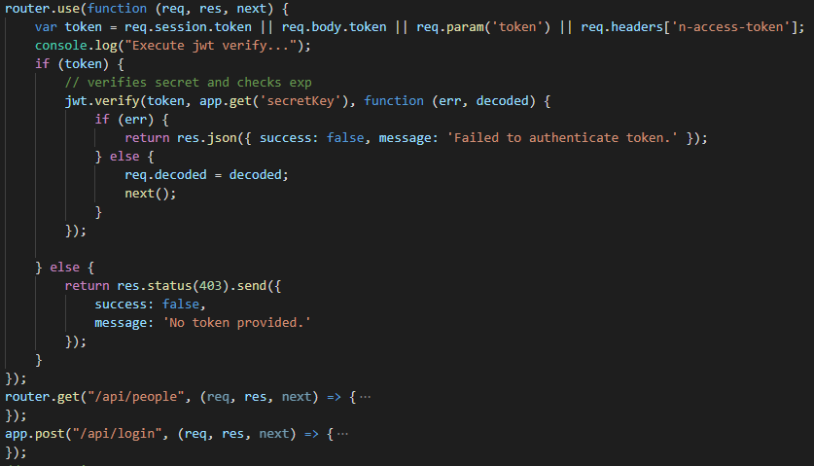
Restful API

Slide 10
Agenda
1. Front-end
II. Back-end

Slide 11
Thank you

